Slide 1

Working with Large Data
Decision support systems Topic

Slide 2


Under supervision
Eng: Mohamed Agami

Slide 3
Presentation Overview
Introduction
Importing Data
Exporting Data
Creating Pivot Tables from External Data
Using Excel as a Database
Practical (DSS) application
Summary

Slide 4


Introduction
The term "Big Data" refers to data that is extremely large, fast, or complex, making it difficult or impossible to process using traditional methods.
Using big data to make informed decisions. Big data is considered a rich source of valuable information that can be used in making strategic, tactical and operational decisions. By analyzing this data, companies and organizations can understand trends, identify opportunities and challenges, and improve operations and performance.

Slide 5
What is large data used with decision support systems?
Big data refers to large and complex datasets that are challenging to manage and analyze using traditional methods.
Why
How
What
Big data is used with decision support systems (DSS) to extract valuable insights and facilitate informed decision-making processes.
Big data is processed and analyzed using advanced analytical techniques, such as machine learning algorithms and data mining, within decision support systems to generate actionable insights.

Slide 6
What is big Large used with decision support systems?
Big data is utilized across various industries and sectors, including healthcare, finance, transportation, retail, and government, to enhance decision-making processes and improve operational efficiency.
Where
When
Big data is continuously generated from various sources, including social media, sensors, transactions, and mobile devices, providing a continuous stream of data for decision support systems to analyze and derive insights from.

Slide 7



Tools used in large data
Python
Here we will use Excel
Power BI
Excel

Slide 8
Importing Data
Excel offers many tools for working with and analyzing large amounts of data. In many cases, an Excel user may not be given data in a worksheet to manipulate. If this is the case, you can use the Import options in Excel to transfer this data to a worksheet were Excel analysis tools can be applied. There are three sources from which you can import data into Excel
text file,
Web address
databases.

Slide 9
Text file
To import data from a text file into Excel, utilize the Text Import Wizard, which automatically appears when opening a text file in Excel. Follow three simple steps within the Wizard. First, select how you want to organize your data into columns: Fixed Width or Delimited. With Fixed Width, Excel automatically separates data into columns; with Delimited, specify the separator character (e.g., commas, spaces). In the second step, modify Excel's column separation guess. In both options, the third step allows specifying numerical formatting for imported data. Explore the Text Import Wizard further through an illustrative example.

Slide 10

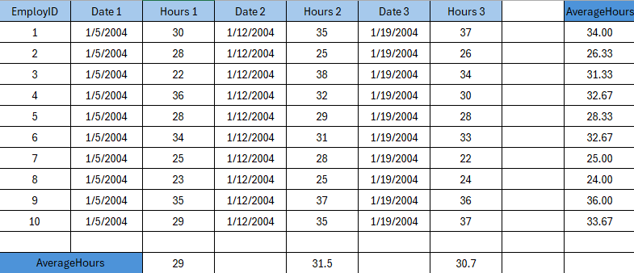
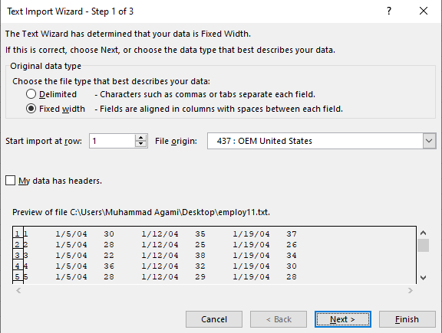
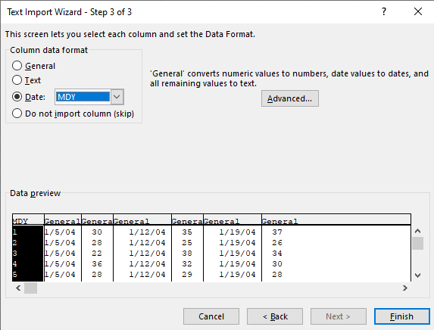
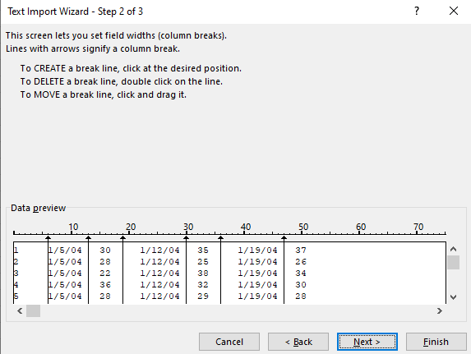
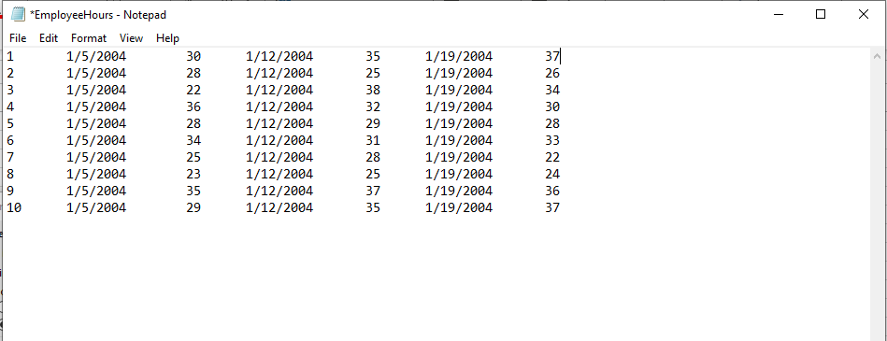
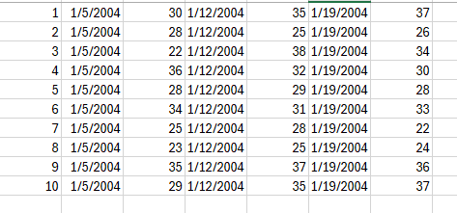

Text Import Wizard through an example
Step 2 :-
In the wizard's first step, select the option; ensure tab separation for text data. In step two, choose "Tab" as delimiter. Preview columns; use "Other" with "/" for error preview."
Step 4 :-
We're now done with the Text Import Wizard; The text data should now be imported into...
Excel columns, as shown
In this step :-
Provides a text file that records the number of hours worked by ten employees
For three consecutive weeks. The file records each employee's start date and hours
It worked for three weeks. This file is saved as a ".txt" file.
Step 1 :-
Of the Excel tools and functions that will help her achieve this, she should import this text
File in Excel. After ensuring that the above data is saved as a text file, we open Excel and
Choose File > Open from the menu; Then select the text file above. Import text
Step 5 :-
The employer can now use the Excel AVERAGE function to calculate averages
She was searching for (per employee and per date). It can also organize its data by
Add column headings and other formatting
Step 3 :-
choose digital file format. For text, select 2nd, 4th, and 6th columns as dates. Choose "Date: MDY" format for these. Keep other columns in 'General' coordination.

Slide 11

Web Addresses
"To import data from a webpage, go to Data > Import External Data > New Web Query. Enter the web address in the dialog box. Preview the site, selecting specific data sections marked by arrows. Click Import. Excel will prompt for a destination cell. Data will be imported and separated into columns. Excel usually guesses the separation well. Rearrange data in the spreadsheet as needed."

Slide 12
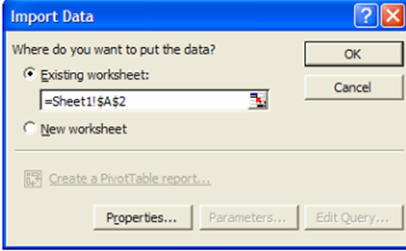
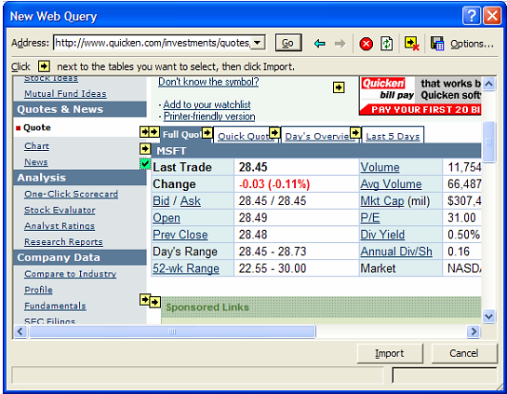
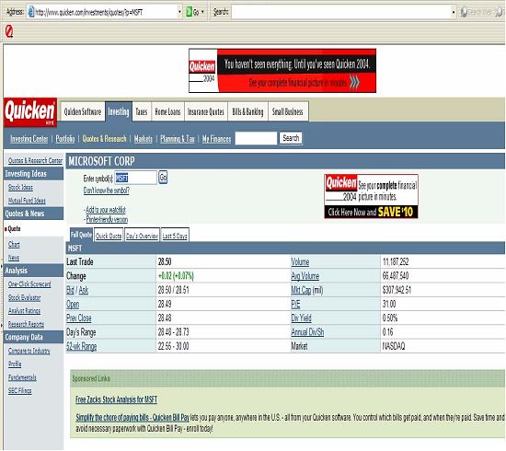
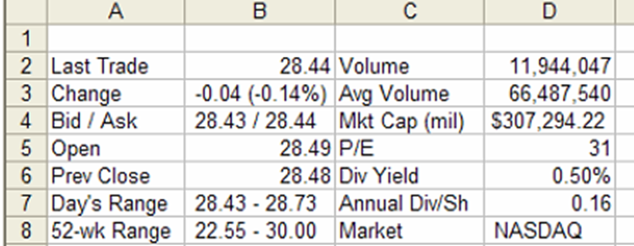
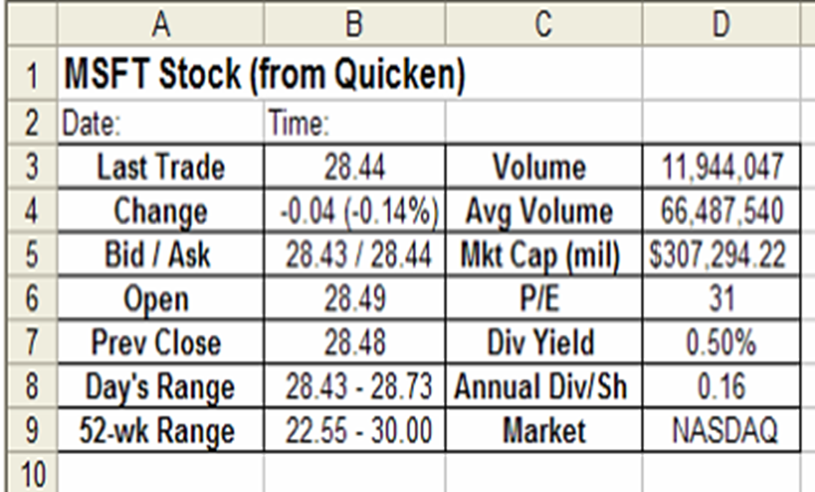
Example on the web Addresses
The data has now been transferred to the worksheet, as shown in the figure. Axel has risen. It also formed the appropriate columns.
In the web page preview, Excel arrows define different data sections. Choose the arrow next to Last Traded for the stock data. Clicking it selects the data. Then click Import. Select the worksheet destination to paste the data.
Format data for analysis. Add a title to the table and a space for the query date/time. Record the 'Last Transaction' values ​​for future reference. To update, select the queried data range and go to Data > Update Data from the menu. Web page changes will be reflected in the worksheet
"To maintain a worksheet for stock portfolio analysis, copy the webpage's URL. Select Data > Import External Data > New Web Query. Paste the URL in the Title window of the dialog box."
Let's consider an example. The following web address contains current stock prices and Information about MSFT stock
Click here

Slide 13
Databases
To import data from a database, choose Data > Import External Data from the menu.
From here you can browse to find the database file you want to work with. These the files don't have to be other Excel files; It can be any data access or ActiveX object
Data object. Understanding all of the options available to you at this point will include Databases.

Slide 14
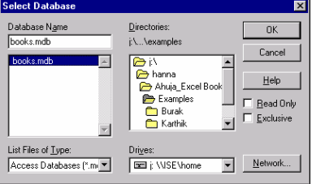
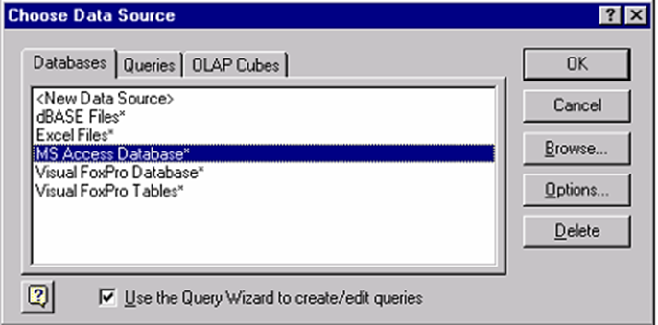
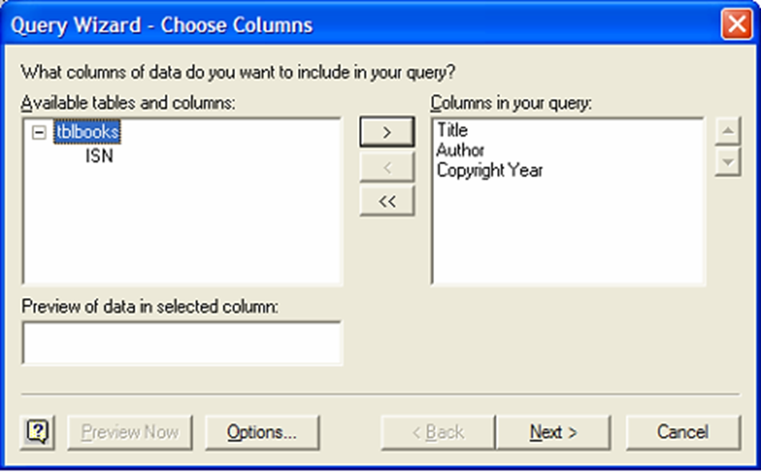
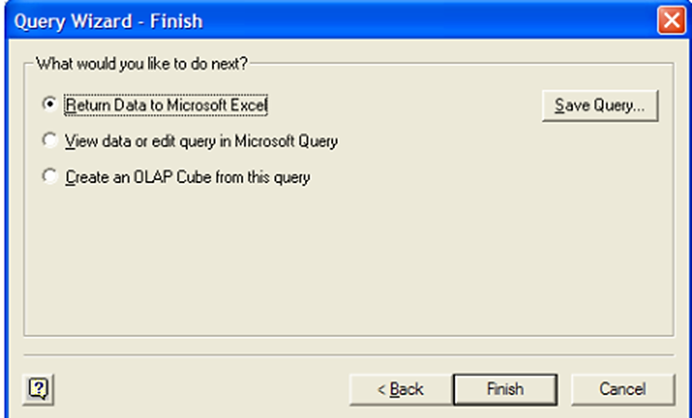
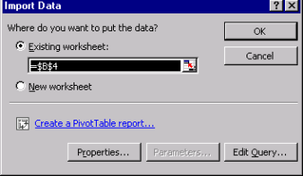
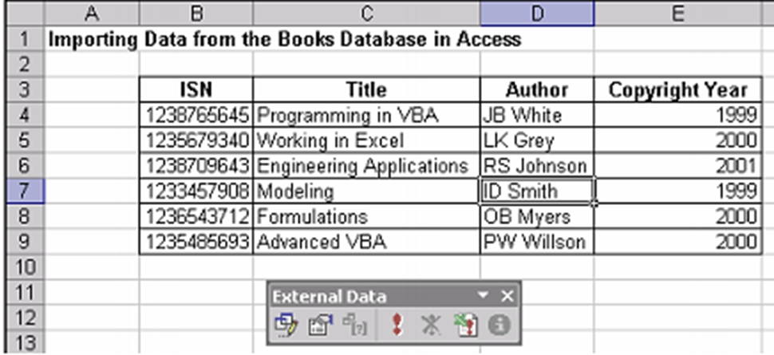
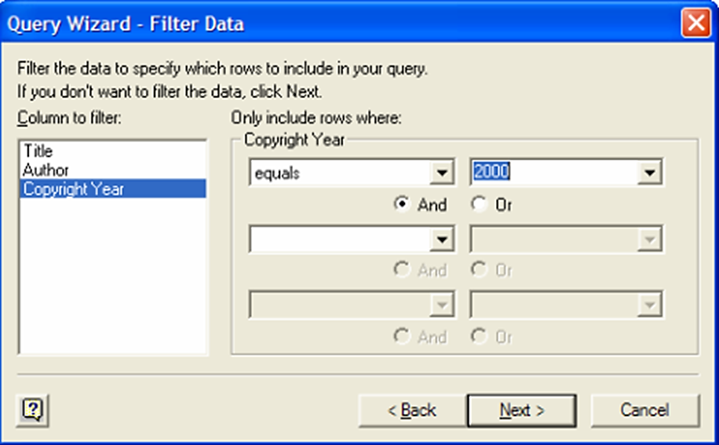
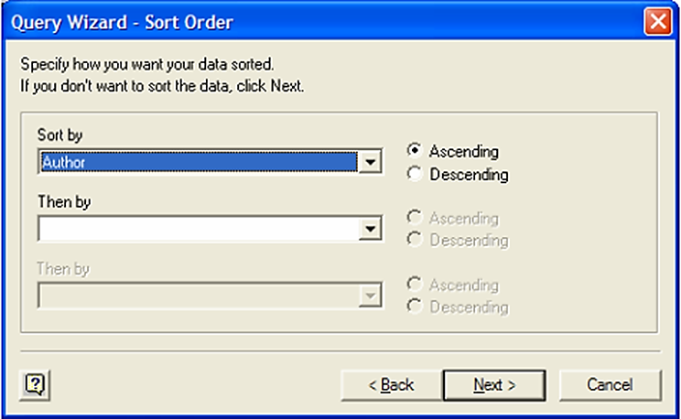
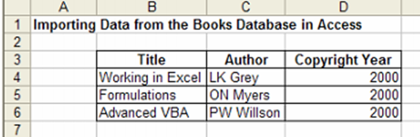
Illustration with an example for this section
After clicking Next, we reach the final step in creating our query. This step requires
We decide whether we want to put the data from this query into Excel and display it in it
The original data source or create an OLAP cube. The first two options are the most
Most used; We will display our data in Excel to display the final data
table, we click Finish
To illustrate the concepts in this section, we will use a previously created database in Microsoft Access. This database is titled Books and has a short record of several books. The fields are: ISN, Title, Author, and Copyright Year. To work with this data in Chapter 10: Working with Large Data Excel, we prepare a new worksheet. First, we choose Data > Import External Data from the menu
Data filtering is how you specify the query. We can choose one or more
Fields, Equality, and Value from the field(s) we want to filter the data by.
Hence, it is necessary to choose how to sort the data in the final table
We have decided to sort by author in ascending order. Again, note that we
It can have multiple types; The section shows an example of multiple sorting.
After we choose a place in our worksheet to place the table, the result of the query is:
Transfer to Excel. We can format this data into a table and use it in our worksheet
The first step in defining our query is to select the columns of data we want
They appear in our final table. We click the + sign next to the table name, tblbooks, to see a
List of all column headings. We choose the title, author and copyright
Columns of the year. We click Next to get to the next step
The next window will provide a list of files that match this data source type. In the list, we should find the file, books.mdb; We select it and click OK. now,
We start defining our query.
Now, we decide how we want to filter this data. This is the definition of the query. First, we select the column title or field we want to filter our data by.
Then we choose the equality type and value from this field. In this case, we decide
Filter the data by selecting all entries whose copyright year equals 2000 and then clicking
the next. Note that we can have multiple filters between each available field.
Locate the imported data, such as cell B4, and confirm. The data will be copied to the worksheet, as shown in Figure The External Data toolbar appears, displaying the Edit Query and Data Range properties. Edit Query adjusts the sections of the imported database, like filtering. Data range properties improve data display. Use the refresh icon to synchronize with the original database, reflecting changes in Excel.
A more detailed way to run a query on this database using help from Excel is to run the query before we import the data. To do this, from Excel, choose Data > Import External Data > New Database Query. You will then see the window in Figure 10.14, which configures the data source for the query. Since we are using a database in Microsoft Access, the only change we need to make here is to select MS Access Database from the list of Databases; then we press OK.

Slide 15

Databases constitute an important part of Excel applications. Involving VBA code in database applications extends your options in organizing your data.

Slide 16
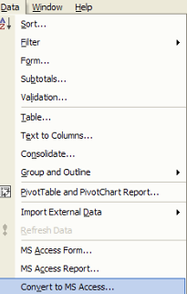
Exporting Data Here are the steps to export data from an Excel worksheet to a Microsoft Access database using the Access Links Add-In:
Open Your Excel Worksheet:
After working with your database in an Excel worksheet, open the workbook containing the data you want to export.
Access Links Menu:
Once the Access Links Add-In is installed, go to the Data menu option in Excel.
Choose Export Method:
From the Data menu, select one of the following three exporting methods:
MS Access Form: Use this option to export data to a Microsoft Access form.
MS Access Report: Choose this method to export data to a Microsoft Access report.
Convert to MS Access: Select this option to convert your Excel data into a Microsoft Access table.

Slide 17

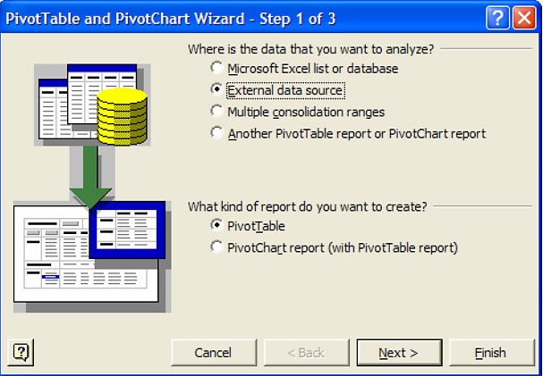

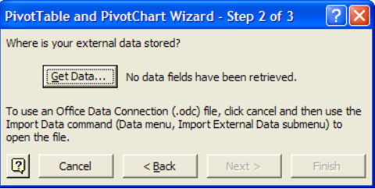
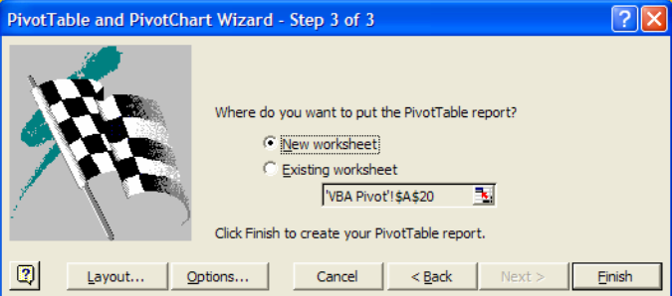
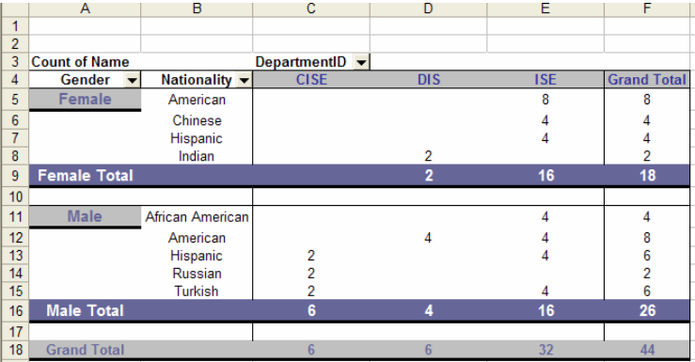
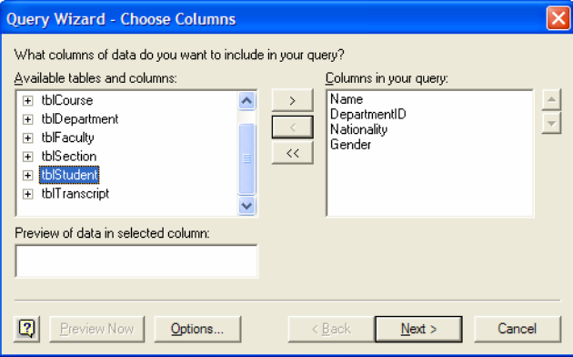
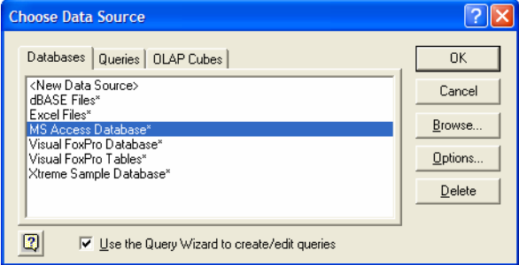
Creating Pivot Tables from External Data
We are now prompted to choose the data within our data source to use for the pivot
table In this example database, we have several tables and queries
of data for a University System Database. Let’s look at the data in the Student Table to
make an analysis of the number of students of each nationality and gender by using a
pivot table. We select the Student Table from the left window and click the + icon. Then,
we select the field names, or column titles, that we are interested in and click the > arrow
to move them to the right window. All of the fields listed in the right window will be
imported to the pivot table.
You can use the data number not only in your spreadsheet, but also from an external data source. In the first step of pivot Table Wizard, we choose the type of data we want to use external data, select an external data source from the list of options.
We are now ready to return to the Pivot Table Wizard. Just as we did in Chapter 6, we
specify the layout and location of the pivot table along with any options presents the final pivot table. We can see the number of students
per nationality and per gender for each department.
The final pivot table with the external data.
We will then be prompted to select the actual data To specify the
data type and location, we click Get Data.
We will use some example data from a Microsoft Access database file. We select MS
Access Database from the list of options

Slide 18
Using Excel as a Database
Sorting
Filtering
Dfunctions
Data Validation
Data Consolidation

Slide 19
Sorting
The first database function we will discuss is sorting. Sorting means arranging all entries
In a database with a specific domain; The field is the class name

Slide 20

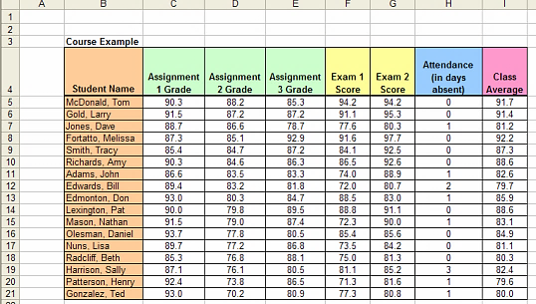
In the example shown, we see that the students' names are in no order. To put The names are in alphabetical order, we can sort the entire database by student field name.

Slide 21
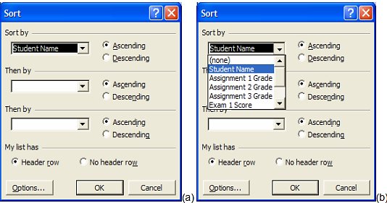
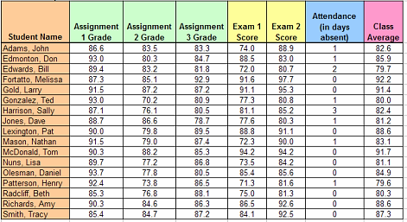
Steps to make the Sorting (1)
To sort data in Excel, select the range (B4:I21), then choose Data > Sort. A window like Figure 1 will appear1.
you can select any field name to sort by; for example, choose “Student Name” in Ascending Order to list last names alphabetically. The ascending and descending icons at the top of the window will automatically sort the highlighted database by the first field

Slide 22
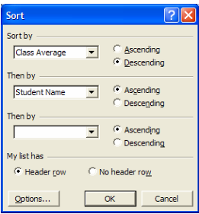
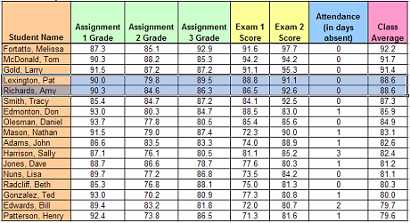
Steps to make the Sorting (2)
When sorting data in Excel, you can sort by multiple fields. For instance, in Figure 10.31, we sorted by **Class Average** (Descending Order) and then by **Student Name** (Ascending Order). Note that you can sort by up to three fields simultaneously.
First sorting by Class Average in Descending Order and then by Student Name in Ascending Order. The database is now sorted.

Slide 23
Summary of Sorting
Sorting: Ordering all entries in a database by a particular field.
Field: Name of a category by which items are grouped in a database

Slide 24

Filtering
The next database function we will discuss is filtering.
Filtering is different from sorting
It selects a specific set of data from the database rather than requesting the entire set Database.
Filtering allows you to select a set of entries in an equal database Enter specific data into the field

Slide 25
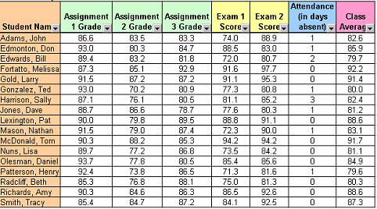
For example, referring to Figure instead of By arranging all the data by sorting by class average, we can choose to display only the row Items with a category average of 88.6. To do this, we start by highlighting The entire database, including column headings and cells B4:I21. Then we choose Data > Filter > Auto filter from list. This selection will transform the database by adding drop-down arrows to each field

Slide 26
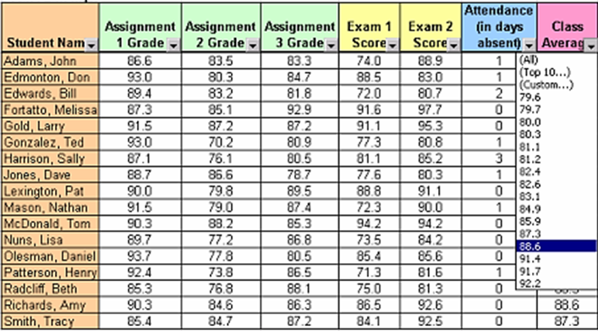
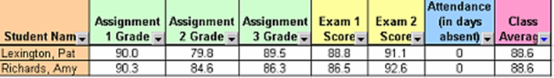
Steps to make the Filtering
Selecting the drop-down list of values in the Class Average field.
The database is filtered to only show data entries with a Class Average equal to 88.6
Select the arrow attached to the Category Average field.
Define a data value (e.g., 88.6) to filter the database.
Only display rows where the class average entries match the chosen value.
To view the entire database again, click the option arrow for the category average and choose “All”

Slide 27
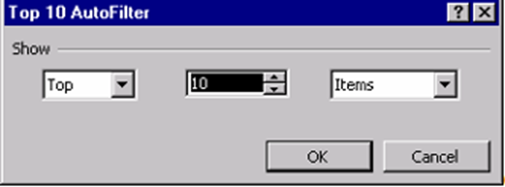
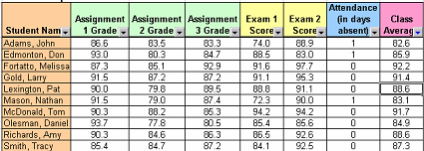
Steps to make the Filtering
Top 10: This option displays either the top or bottom 10 entries (or a specified amount) based on your preference.
Custom: With this option, you can define specific criteria for filtering the data.
Choosing the Top 10 option from the drop-down list.
Specifying
Top or Bottom, a certain number, and items or percent.
The database is updated to
show only the number of entries specified.

Slide 28
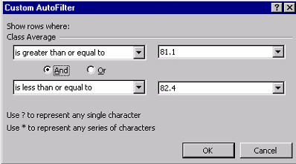
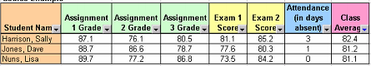
Steps to make the Filtering
electing the Custom option.
Specifying to show only entries with
Class Average values greater than or equal to 81.1 and less than or equal to 82.4.
The database is updated to show only these entries.
The Custom option provides a set of inequality specifications. You can filter entries based on whether their field value is less than, greater than, or equal to a specified value. Additionally, you can narrow your search to a specific range of values. For instance, in the figure, we’ve chosen a list of entries where the average separation falls between 81.1 and 82.4

Slide 29
Summarize in filtering
Filtering is useful for locating specific data correlations in a database.
You can define a select group of data by choosing a field entry that they have in common.
There are many applications of databases for which filtering will be a necessary tool.

Slide 30

Dfunctions
There is a group of Excel functions that are meant specifically for working with Excel as a database; we call these functions Dfunctions. These are specific functions designed for use with databases. They include
DSUM
AVERAGE
DMAX
DMIN
MIN
DAVERAGE
MAX
SUM
Is not

Slide 31

DMAX (Example)
DMAX function in Excel is a database function that returns the maximum value selected from a database table-like array or range using a specified condition.
ItemName | Sales
A | 1000$
B | 2500$
A | 3500$
C | 800$
A | 6000$
M | 8560$
A | 6950$
B | 7580$
N | 3650$
6950
DMAX(database, field, criteria)
ItemName
A

Slide 32
DMIN (Example)
The Excel DMIN function returns the minimum value in a field, from a set of records that match criteria. Use the MAX function to get the maximum value.
ItemName | Sales
A | 1000$
B | 2500$
A | 3500$
C | 800$
A | 6000$
M | 8560$
A | 6950$
B | 7580$
N | 3650$
2500
DMIN(database, field, criteria)
ItemName
B

Slide 33
DSUM (Example)
The function helps to calculate the sum of a specific field/column in a database for selected records based on user-specified criteria
ItemName | Sales
A | 1000$
B | 2500$
A | 3500$
C | 800$
A | 6000$
M | 8560$
A | 6950$
B | 7580$
N | 3650$
21100
DSUM(database, field, criteria)
ItemName
A
N

Slide 34
DAVERAGE (Example)
DAVERAGE calculates the average of the numeric values in the cells (fields) of the specified column, for all rows (database records) that match the specified search criteria.
ItemName | Sales
A | 1000$
B | 2500$
A | 3500$
C | 800$
A | 6000$
M | 8560$
A | 6950$
B | 7580$
N | 3650$
3626.67
DAVERAGE(database, field, criteria)
ItemName
A
C

Slide 35
Type of COUNT function
COUNT
COUNTA
COUNTBLANK

Slide 36
Example of COUNT function
Category
25
24
65
46
Mohamed
45
Mariem
52
55
The COUNT function tallies numeric values in a list of arguments.
7
The COUNTA function tallies non-empty cells in a range
9
count the number of empty cells in a given range of cells
2

Slide 37
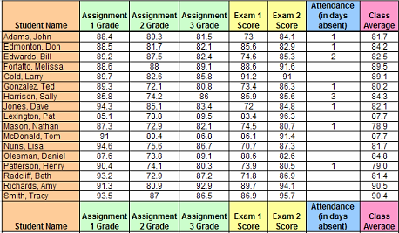
Application of DFunction
Calculate DMAX, DMIN, DSUM DAVERAGE
Calculate COUNT, COUNTA, COUNTBLANK

Slide 38

Summarize in DFunction
functions: Functions with extra criteria specified for database use DSUM, DAVERAGE, DMIN, DMAX

Slide 39

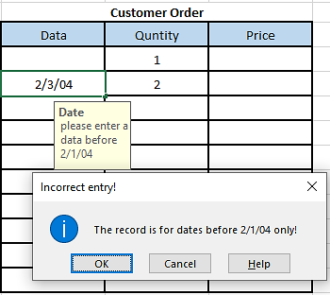
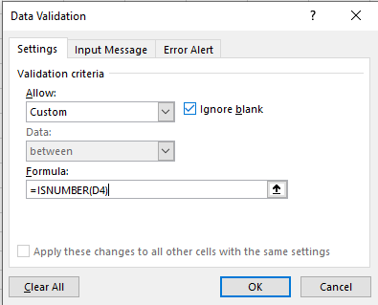
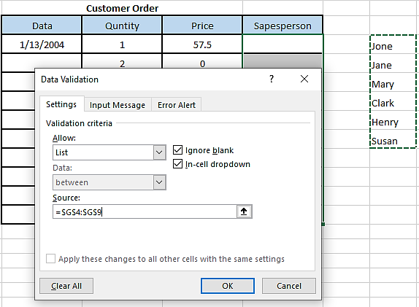
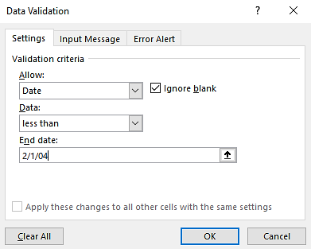
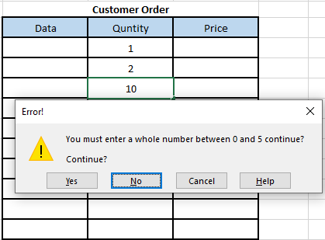
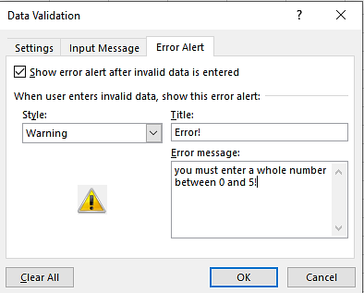
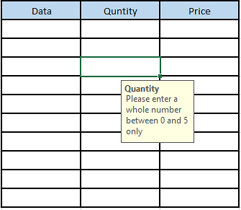
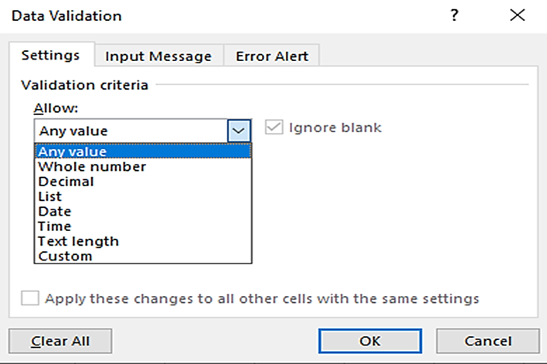

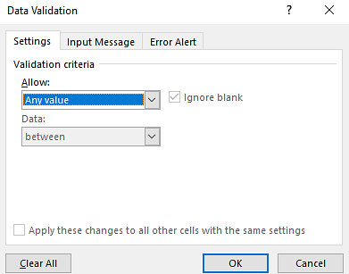
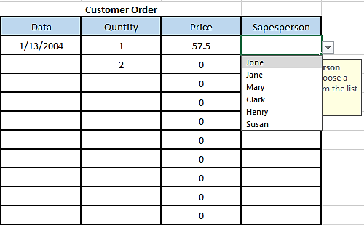



Data Validation
Let’s consider an example. Suppose we have a record of customer orders. For each
order, the date, quantity, and price of the order are noted. If a maximum of 5 products
can be sold in one order, we can apply the above Whole Number validation to the
Quantity column. The Input Message for this validation appears when a cell in the
Quantity column is selected (see Figure 10.51). If we enter a number greater than 5 (or
less than 0), then the Warning message created in the Error Alert tab will appear
Another interesting criterion, Custom, is like the Formula Is option used in
Conditional Formatting (see Chapter 4). With the Custom criterion, the user applies a
formula to the first cell in the selected range that is being validated. For example, in
Figure, we are checking if the value entered is a number or not by using the
Informational function ISNUMBER. If the result of this formula is false, then the Error
Alert message will appear.
The Error Alert allows you to display a message to the user after he or she has entered
any data incorrectly. You can choose to have an Error, Warning, or Information symbol
on this message box also; each symbol has a different set of options for the user in the
message box. we have chosen the Warning symbol and have entered
the message, “You must enter a whole number between 0 and 5!
Most database applications have a data validation tool. Forces a specific format or The type of data that a user must enter for a particular entry. Excel offers this tool when...
Working with big data. To use data validation, select the cell(s) you want to validate Then click Data > Validation from the menu. The window shown below will appear
The last unique criterion is the menu. It allows you to create a list box, or drop-down box, with options for users to choose from as their input value. We must create a source for this list somewhere in the spreadsheet. For example, if we have an additional column in the Customer Orders table for the salesperson who received the order, we might want to limit that entry to the list of valid salespeople who work for the company. In the spreadsheet below, there is a list of sales representatives. We can then select a list of criteria options and highlight this namespace as the source
The Input Message tab allows you to create a comment that will appear next to the cell
after it is selected. This message is intended to guide the user to enter the correct data.
For example, we have created the message “Please enter a whole
number between 0 and 5 only.” This message matches the criterion we specified.
There are three main tabs in this window: Settings, Input Message, and Error Alert. In
the Settings tab, you specify the criteria for the data that will be entered into the selected
cell. As shown in Figure, there is a list of criteria including Whole Numbers, Dates,
Text Lengths, and others.
Depending on which criteria are selected from the list, you will have a few more options
to further specify these criteria. For example, if we choose Whole Number from the list,
we then choose from a list of inequalities (greater than, less than or equal to, between,
etc.) and provide some numerical bounds
Then, we can set the Input Message and Error Alert so that the users know they can
only enter a salesperson name from the provided list. When they select a cell from the
Salesperson column, a drop-down arrow will appear providing them with this list of valid
names
This time, let’s choose the Information alert type. The Input Message and alert are
shown in Figure for a selected cell in the Date column.
We could also validate the Date column in this example by choosing the Date criterion.
We may, for example, specify that this record is for dates before February 1st only
When selecting the validated cell, the Input Message appears

Slide 40

Data Consolidation
Another database tool available in Excel, Data Standardization, allows you to compare and merge multiple sources of data into a new spreadsheet. It can also be monotheism
This is accomplished using the "Multiple consolidation ranges" option for pivot tables; but Sometimes a data standardization tool may be easier to use

Slide 41


Example of Data Consolidation
Let’s consider an example. Suppose that we have monthly sales recorded for various products in two different marketing regions. If we want to know the total sales per month (among all regions) for each product, we will want to use data consolidation.
A record of monthly sales per product for two different regions

Slide 42


Step solve of Data Consolidation
We begin by creating a new spreadsheet (right-click on a sheet name and choose Insert> Worksheet from the list of options). In this new sheet, we select Data > Consolidate from the menu. The window shown below will appear
After selecting the function, we must choose the references of the data that we want to consolidate. In this case, we select the entire table from both the Region 1 Sales and Region 2 sales spreadsheets. Next, we select the Top row and Left column check boxes for the location of data labels. We also make sure to check the box “Create Links to source data.” This option ensures that any change made to the source data will be reflected automatically in the consolidated table. The completed data consolidation window appears in Figure

Slide 43



The summation to transform the result
sum

Slide 44

The result

Slide 45

Summary
You can import text files, web page information, and database fields into Excel using External Data Import Wizard.
Queries can be performed on data that is imported from the database.
Using the Access Links add-in, data can be exported to a database.
Pivot tables can use external data, such as data from and sourced from databases.
Sorting and filtering are useful tools for organizing large data.
There are many functions, called Dfunctions, that can be used in big data Excel. There are also some other functions, such as the COUNT and SUMIF functions, Which can be used with big data.
Data validation and data standardization are database tools available in Excel.

Slide 46

Practical (DSS) application
The application talks about proposing to register academic subjects for students based on the student’s previous academic record, and based on that, it is analyzed using the Excel countries used in decision-making, and then the most appropriate subjects for the student are chosen.

Slide 47


Problem Solving Steps
Information about the problem
Define
Define The Problem
Based on the provided information, the problem structure can be described as semi-structured.
Analyze
Analyze The Problem
Generate
Generate Possible Solutions
Select
Select The Best Solution
Based on the description provided, this problem can be classified as operational
Plan
Plan For Implementation
Implement And Evaluate
Implement And Evaluate The Solution

Slide 48
System Components
Database
Database management system
Data directory
Query facility

Slide 49












Login page (administrator)
Username : BFCAI
Password : bfcai123456+
You can log in as a student and the available permissions are:
View portfolio
Course registering
Grade
GPA
Change Password
Through this page, the administrator can use the following powers:
Add, edit, or delete a student, doctor, or course
Determine the semester
Pay student fees
Registering materials for the student
You can log in as a doctor and the powers available to him will be:
View portfolio
View register
Add mark for students
Change password
Here the DSS system suggests to the student the subjects that the student must register, and the student here has the choice between choosing this offer or changing it.
The DSS system suggests the subjects that the student should register to the administrator , and then he must choose or modify this suggestion.
From here, the student can know all his grades in detail, and then calculate the GPA and semester grade
Through this page, the doctor can specify the subjects that will be taught and then view the students registered in the subject and know their grades
The Administrator must specify the student number from here
Through this page, you can enter by choosing 3 actor: the administrator, the doctor, or the student. We will enter as a administrator

Slide 50



Solve the problem 1&2&3
Data Analysis: Excel provides built-in tools for data analysis, including sorting, filtering, and pivot tables. These tools can help organize and analyze the student's previous academic record efficiently.
Conditional Formatting: Conditional formatting in Excel allows you to visually highlight certain data based on specific conditions. This can be useful for identifying trends or patterns in the student's academic performance.
VLOOKUP and INDEX-MATCH: These functions can be used to search for specific information within a dataset. For example, you can use VLOOKUP or INDEX-MATCH to match a student's previous academic record with a list of available subjects and their requirements.

Slide 51



Solve the problem 4&5&6
Decision Trees: Excel can be used to create decision trees or flowcharts to visualize the decision-making process. This can help determine the most appropriate subjects for the student based on their academic record.
Solver Add-In: Excel's Solver add-in can be used to optimize decision-making processes by finding the best solution given certain constraints. For example, you can use Solver to maximize the number of subjects a student can take while meeting specific criteria or constraints.
What-If Analysis: Excel's What-If Analysis tools, such as Goal Seek and Scenario Manager, allow you to explore different scenarios and their potential outcomes. This can be useful for evaluating the impact of different subject choices on the student's academic performance.

Slide 52





The tools used
tools | Name tools
IDE
NetBeans
programming Language
Java
Database
Microsoft Access
Add excel tools (API)

Slide 53


Reference
Developing Spreadsheet-Based Decision Support Systems
https://support.microsoft.com/en-us/excel
https://www.ekb.eg/ar/home

Slide 54

Tank you

